Slide 2
What’s New in Xamarin?

Slide 3
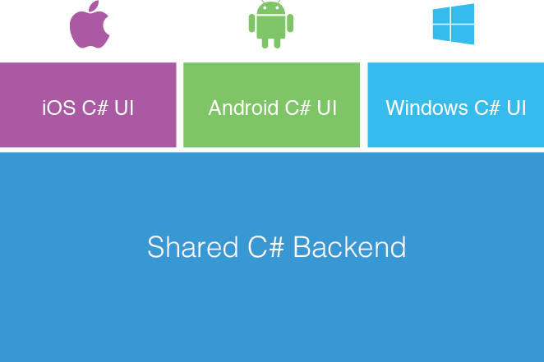
Xamarin Approach

Slide 4
Xamarin Forms Approach
Shared UI Code

Slide 5
Shared vs .NET Standard
A Shared Project is not directly compiled (.dll is not generated), instead files are compiled into .dll of project that references it
Can write platform specific code in a same file using compiler directives #ifdef
Cannot be used other than Xamarin projects
.NET projects are compiled in portable assemblies that run in any .NET based runtime.
Platform specific code cannot be implemented inside a .NET Standard
project
Better usability and compatibility across other .NET platforms

Slide 6
What’s new in Xamarin Forms?

Slide 7
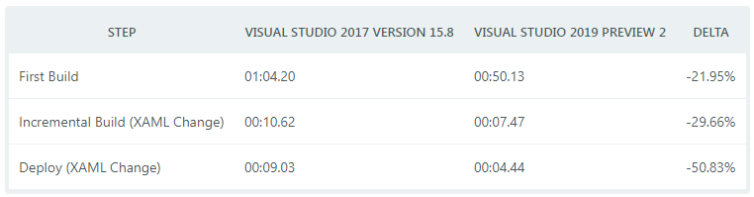
Faster Inner Development Loop
Smaller Workload Size
Visual Studio 2019 have decreased the size of the Xamarin workload by 50%!

Slide 8
Android Announcements
Enhanced Fast Deployment for Android
Android Support Library v28

Slide 9
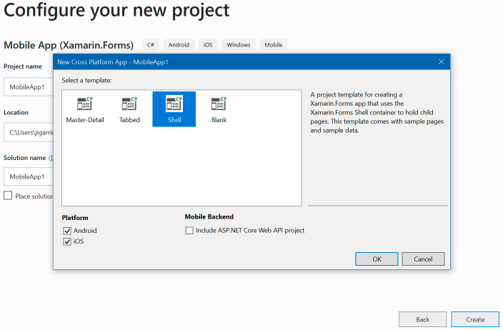
Xamarin Forms Shell Template
Shell provides a guided structure for setting up your applications navigation UI, a powerful new URI based navigation service, performance conscious data templates.

Slide 10
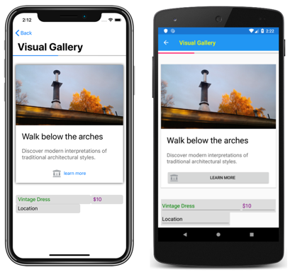
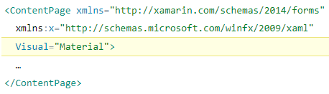
Consistent UI with Visual
Forms.SetFlags("Visual_Experimental");
Notes:
Button
Entry
Frame
ProgressBar

Slide 11
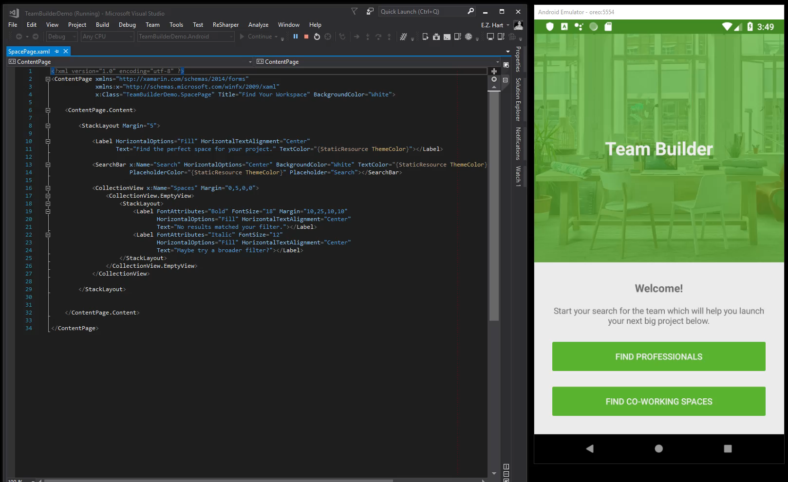
Xamarin.Forms CollectionView
Forms.SetFlags("CollectionView_Experimental");
Notes:
CollectionView and ListView APIs are similar, there are some notable differences:
CollectionView has a flexible layout model, which allows data to be presented vertically or horizontally, in a list or a grid.

Slide 12
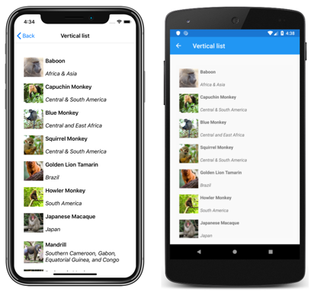

Slide 13
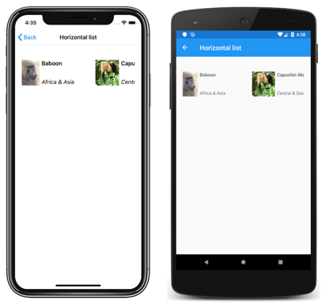

Slide 14
Cross-Platform Access to Platform Services
Xamarin.Essentials 1.0 is now available.
Easier than ever to access non-UI platform APIs from shared code.
Supported Platforms
iOS (10+)
Android (4.4+)
https://github.com/xamarin/Essentials

Slide 15
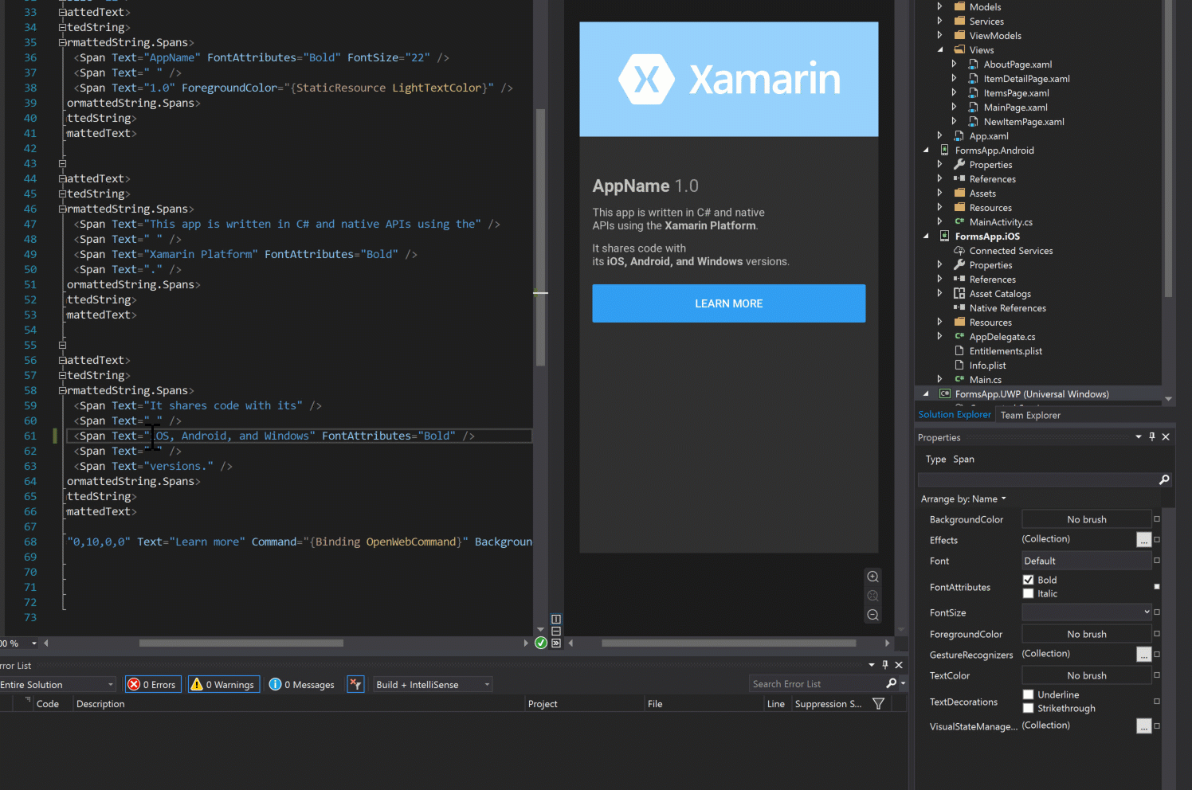
Xamarin.Forms Property Panel

Slide 16
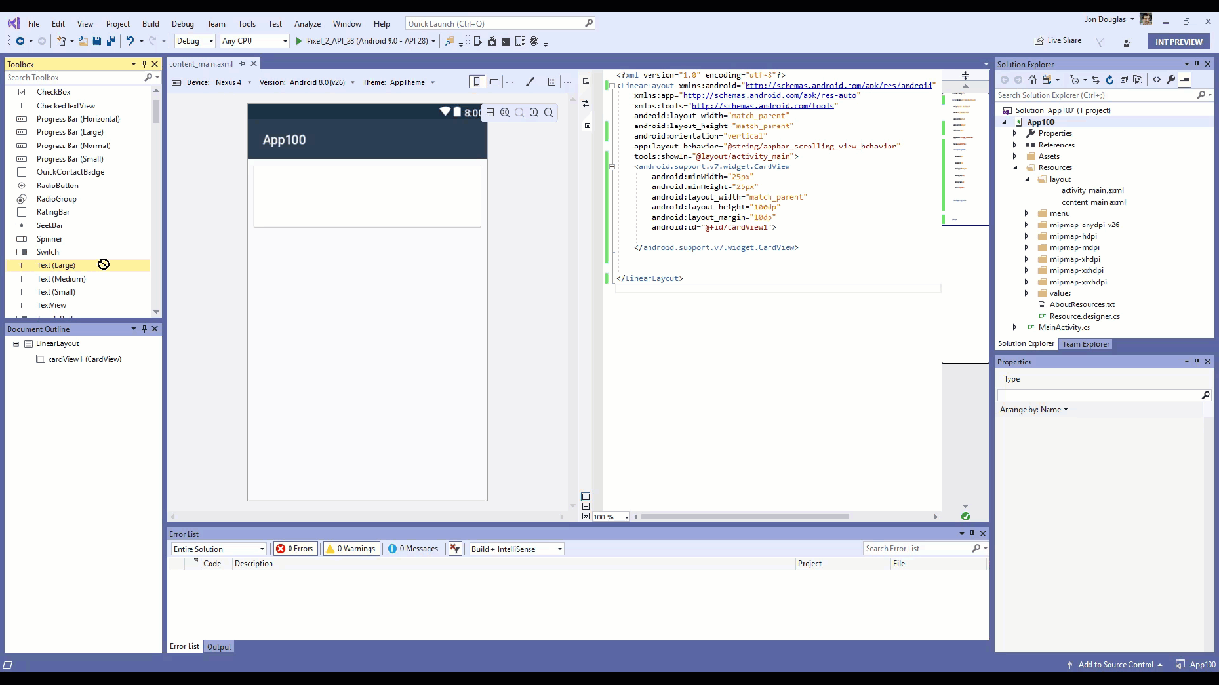
Xamarin Android Designer

Slide 17
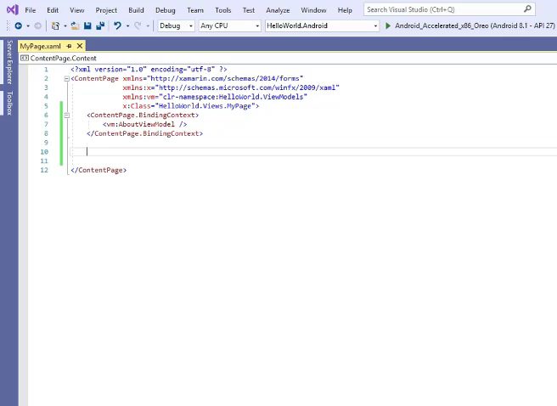
XAML IntelliSense

Slide 18
More…
https://blog.xamarin.com/connect-2018-xamarin-announcements/
https://blog.xamarin.com/whats-new-for-xamarin-developers-in-visual-studio-2019-preview-2/

Slide 19





THANK YOU
Anbu Mani
Software Engineer
https://xmonkeys360.com
@Anbu_Mani27
@AnbuMani27
@AnbuMani27
@AnbuMani27

